Slide 1
Stone-Paper-Scissor Game
-ML Project

Slide 2
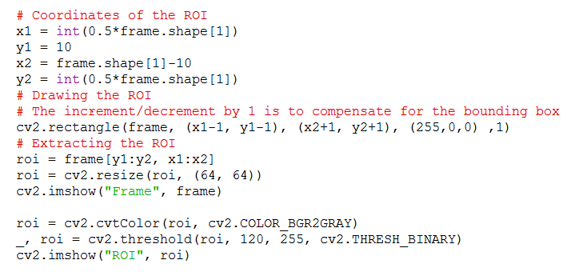
Collecting Data (Images)
check,frame = cap_video.read()
# Simulating mirror image
frame = cv2.flip(frame, 1)
# Coordinates of the ROI
x1 = int(0.5*frame.shape[1])
y1 = 10
x2 = frame.shape[1]-10
y2 = int(0.5*frame.shape[1])
# Drawing the ROI
cv2.rectangle(frame, (x1-1, y1-1), (x2+1, y2+1), (255,0,0) ,1)
# Extracting the ROI
roi = frame[y1:y2, x1:x2]
roi = cv2.resize(roi, (64, 64))

Slide 3



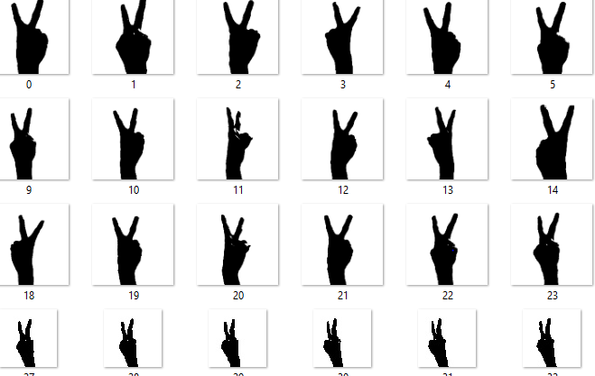
Stone
Paper
Scissor

Slide 4
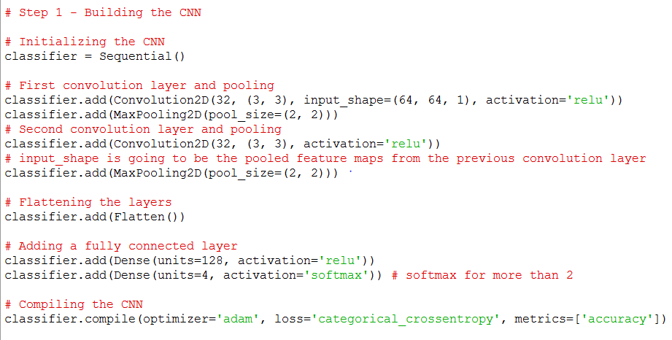
Train Model Using CNN

Slide 5
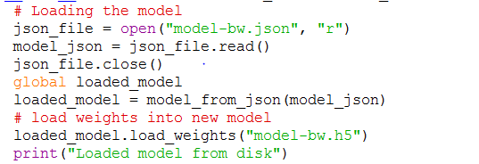
Prediction

Slide 6
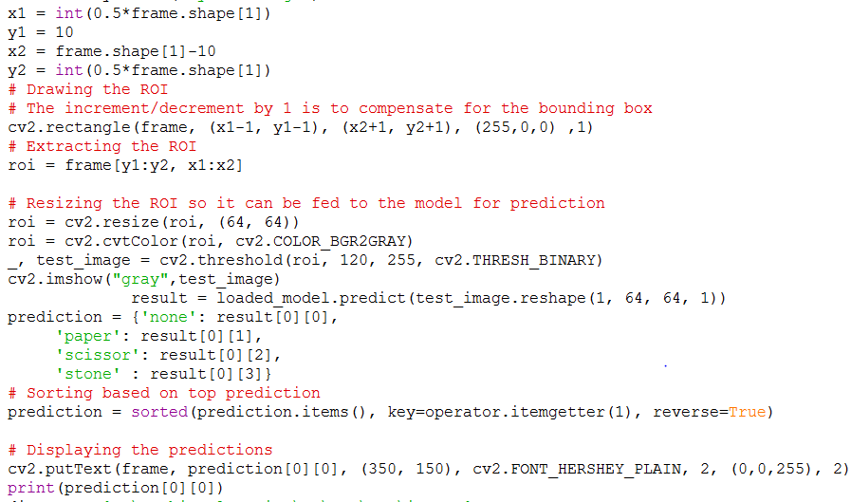

Slide 7
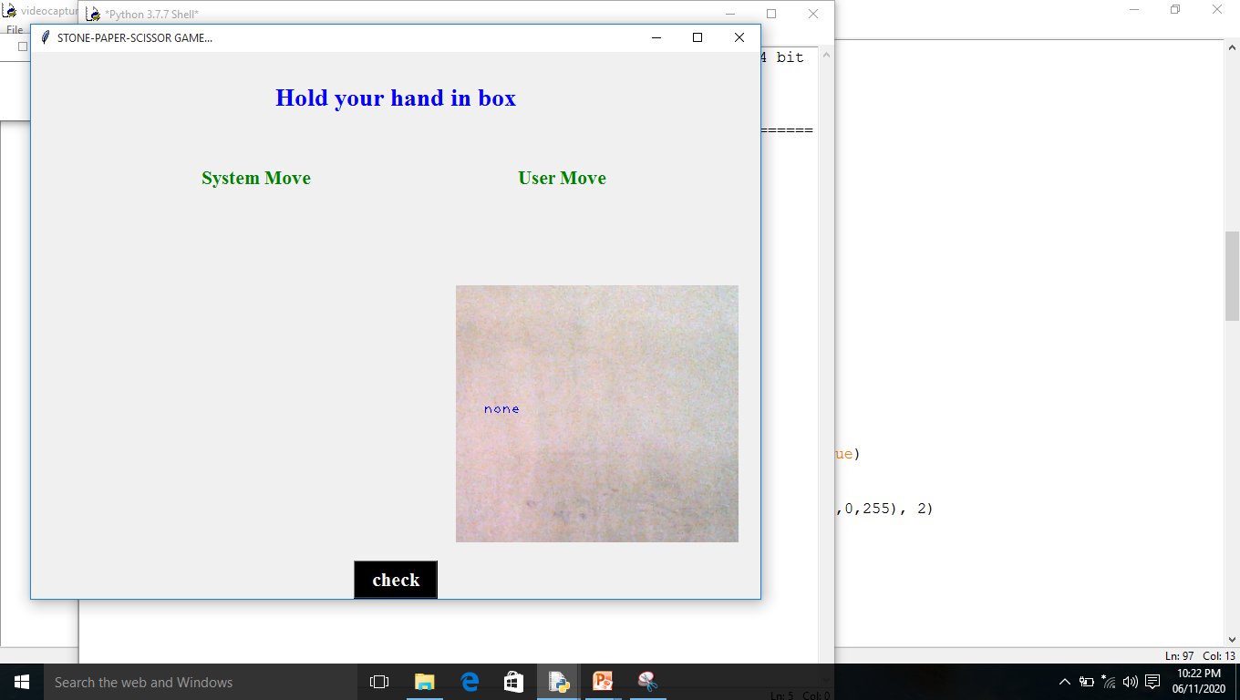
Output

Slide 8
